Slide 1
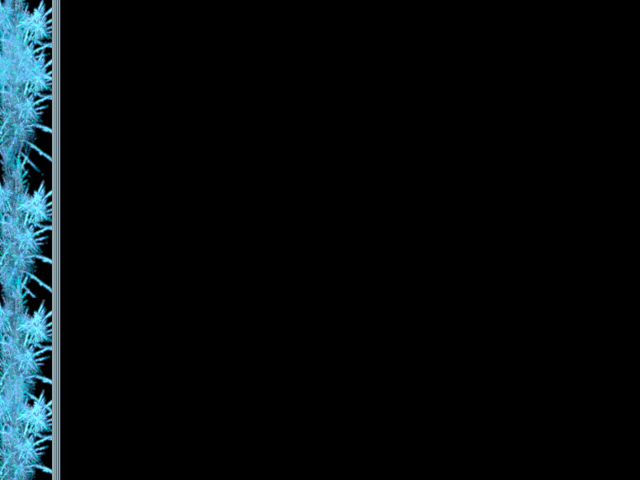
How do proteins die?
Immortality and you

Slide 2
An Overview of Protein Death
I. Protein killers
  Focus on Free Radical oxidation
II. Need for the removal of dying proteins
  Focus on aggregation
III. Labelling of dying proteins
  Focus on Ubiquitin
IV. Degredation of dying proteins
  Focus on the Ubiquitin-Proteasome System

Slide 3
1. Protein Killers
Denaturization
  Heat shock
  pH
  Ion Concentration
Chemical Reaction of the Protein
  Carbonyl bonding
  Free Radicals (perhaps most interesting)

Slide 4
Free Radicals
Uncharged atoms or molecules with an unpaired electron shell that makes them very reactive.
Free radicals result from ionizing radiation during redox reactions.
The oxygen radicals •OH (the hydroxyl radical) and O²•¯ (the superoxide anion) arise from oxidations involving water, and are the most common free radicals in living things.
Only combining with another free radical can halt the destructive cycle that free radicals introduce, or antioxidants like vitamin C
Free radicals drastically damage proteins
Notes:
Mitochondria,

Slide 5
The effects of Free Oxygen Radicals
Destroying the structure of the protein
  By denaturing secondary and tertiary structure
  By cleaving proteins into modified peptides
Aggregation of proteins
  Due to formation of protein-protein cross-links
  Due to hydrophobic domains becoming exposed

Slide 6
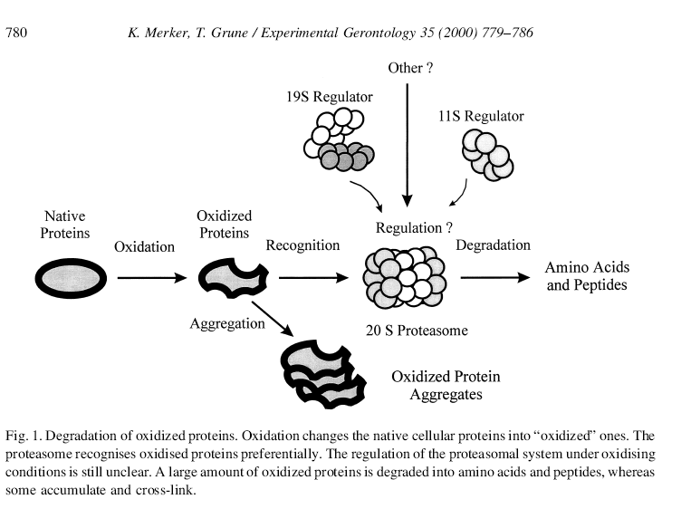
Protein Aggregation
Bullets

Slide 7
2. Need for the removal of dying proteins
Lost functioning of oxidatively stressed proteins
Conservation of the raw material of amino acids and the energy that they contain
Regulation of Cell Cycles like division, and transcription
Removal of protein aggregates (the buildup of which is often seen in diseases like Alzheimer’s and Parkinson’s)

Slide 8
Types of Degredation
Mass digestion by proteases in the Lysosome
Refolding of salvageable denatured proteins by Chaperone proteins
Selective degredation by the Ubiquitin-Proteasome system

Slide 9
Ubiquitin Labelling
Ubiquitin (a relatively small 76 Amino Acid protein)
  A label that binds covalently to lysine residues of target proteins to mark them for degredation
Has the following shuttling proteins
  Ubiquitin-activating enzyme E1
  Ubiquitin-conjugating enzyme E2
  Ubiquiting-protein ligase E3

Slide 10
Material
Bullets

Slide 11
Material
Bullets

Slide 12
Material
Bullets

Slide 13
Material
Bullets

Slide 14
Material
Bullets

Slide 15
Material
Bullets

Slide 16
Material
Bullets

Slide 17
Material
Bullets

Slide 18
Material
Bullets

Slide 19
Material
Bullets

